Slide 1
Relevant Papers
Jan. 22, 2020

Slide 2
Data-to-Text Paper
Enhanced Transformer Model for Data-to-Text Generation Li Gong, Josep Crego, Jean Senellart
The task: generate a textual description from a given input of structured data

Slide 3
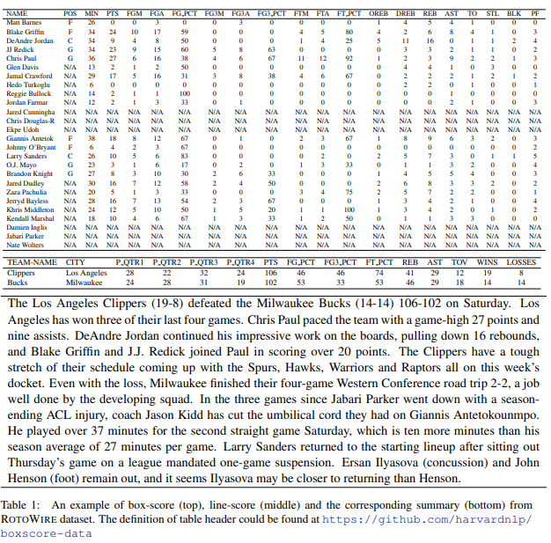
The Dataset: ‘Rotowire’
A dataset of NBA basketball game summaries, paired with their corresponding box- and line-score tables
contains 4853 summaries in total, in which 3398 summaries are for training, 727 for validation and 728 for test

Slide 4
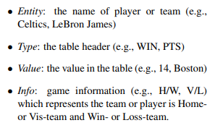
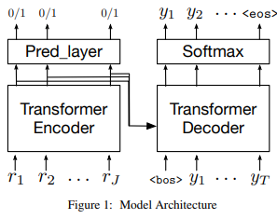
Implementation: Transformer with some modifications
The input of data-to-text model encoder is a sequence of records. Each record is a tuple of four features (Entity, Type, Value, Info)
The features are converted into vectors, and then concatenated together as the embedding of records.
A binary prediction layer is added on top of the Transformer encoder output to predict whether or not one record will be mentioned in the target summary

Slide 5
Content Selection
Content is selected using the self-attention mechanism within the Transformer architecture.
Can generate the latent representation (similarity) for each record by jointly conditioning on all other records in the input dataset.

Slide 6
Encoder-Decoder Semantics
The encoder takes the record embedding of vectors as input and generates the latent representation for each record in the input sequence.
The output of encoder is then used to predict the importance of each record and also serves as the context of the decoder.
The decoder of the model predicts the next word conditioned on the encoder output and the previous tokens in the summary sequence

Slide 7
Proposed Performance Improvements
Synthetic Data Generation:
The paper introduces a method to generate synthetic training data in order to improve the cohesion between the input records and output summary. The authors claim that the model “needs more data to enhance the encoder-decoder attention of the decoder”
Training Data Selection:
A method to output more relations by fine-tuning on the training examples containing a greater number of relations.

Slide 8
Evaluation
The model output is evaluated on general natural language coherence through BLEU, as well as data-to-text metrics proposed by (Wiseman et al., 2017) including the following three aspects:
• Relation Generation (RG) evaluates the number of extracted relations in automatic summaries and their correctness (precision) • Content Selection (CS) evaluates the precision and recall rate of extracted relations in automatic summaries
• Content Ordering (CO) evaluates the normalized Damerau-Levenshtein Distance between the sequence of extracted relations in automatic summaries and that in the human summaries

Slide 9
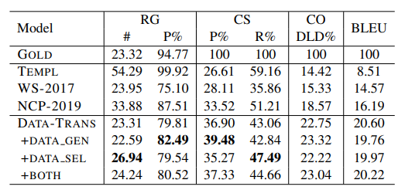
Results
Templ: human-generated
WS-2017 Original data-to-text paper from 2017 (Wiseman et al., 2017)
NCP-2019 Recent data-to text paper (Puduppully et al., 2019)
Data-Trans: This paper
Data-generation: Results with synthetic generated data
Data-selection: results with model fine-tuned on training data with a large amount of relations
Both: Data-gen + Data-sel

Slide 10
Exploring the Limits of Transfer Learning with a Unified Text-to-Text Transformer, Google AI
Transformer-based language model designed for transfer learning to other tasks
Treats every NLP problem as a “text-to-text” problem, i.e. taking text as input and producing new text as output
Allows us to directly apply the same model, objective, training procedure, and decoding process to every task we consider
Can be applied to generative, classification and regression tasks.
Obtained comparable performance to task-specific architectures and ultimately produced state-of-the-art results when combined with scale

Slide 11
The Architecture
An encoder-decoder Transformer implementation that closely follows its originally-proposed form [Vaswani et al., 2017].
Pre-training like bert:
Take a tokenized span of text from the unlabeled text dataset.
The token sequence is processed to produce a corrupted input sequence and a corresponding target.
The model is trained in an unsupervised fashion with maximum likelihood to predict the target sequence

Slide 12
Examples: language translation
To ask the model to translate the sentence “That is good.” from English to German, the model would be fed the sequence:
“translate English to German: That is good.”
and would be trained to output “Das ist gut.”

Slide 13
Examples: Trivia QA
Input: trivia question: in which sea are the cayman islands?
Target: caribbean
Prediction: caribbean
Counted as Correct? True
Input: trivia question: what is an astronomical event that occurs when one celestial object moves into the shadow of another?
Target: eclipse
Prediction: lunar eclipse
Counted as Correct? False

Slide 14
How to use: Load the model
model = t5.models.MtfModel(
model_dir=MODEL_DIR,
tpu=TPU_ADDRESS,
tpu_topology=TPU_TOPOLOGY,
model_parallelism=model_parallelism,
batch_size=train_batch_size,
sequence_length={"inputs": 128, "targets": 32},
learning_rate_schedule=0.003,
save_checkpoints_steps=5000,
keep_checkpoint_max=keep_checkpoint_max if ON_CLOUD else None,
iterations_per_loop=100,
)

Slide 15
Process a dataset to create input to target pairs
ds = tfds.load(
"trivia_qa/unfiltered.nocontext",
data_dir=DATA_DIR,
download_and_prepare_kwargs={"download_dir": "./downloads"})

Slide 16
Define the new task using the processed dataset
def tiviaqa_extract_qa(ds):
def exract_qa(ex):
return {
"question": ex["question"],
"answer": ex["answer"]["value"]
}
return ds.map(exract_qa, num_parallel_calls=tf.data.experimental.AUTOTUNE)
t5.data.TaskRegistry.add(
"triviaqa_context_free",
t5.data.TfdsTask,
tfds_name="trivia_qa/unfiltered.nocontext:1.1.0",
tfds_data_dir=DATA_DIR,
sentencepiece_model_path=t5.data.DEFAULT_SPM_PATH,
text_preprocessor=[tiviaqa_extract_qa, trivia_preprocessor],
postprocess_fn=t5.data.postprocessors.lower_text,
metric_fns=[t5.evaluation.metrics.accuracy]
)

Slide 17
Fine-tune on the defined task
FINETUNE_STEPS = 25000 #@param {type: "integer"}
model.finetune(
mixture_or_task_name="trivia_all",
pretrained_model_dir=PRETRAINED_DIR,
finetune_steps=FINETUNE_STEPS
)

Slide 18
Evaluate accuracy
model.batch_size = train_batch_size * 4
model.eval(
mixture_or_task_name="trivia_all",
checkpoint_steps="all"
)

Slide 19
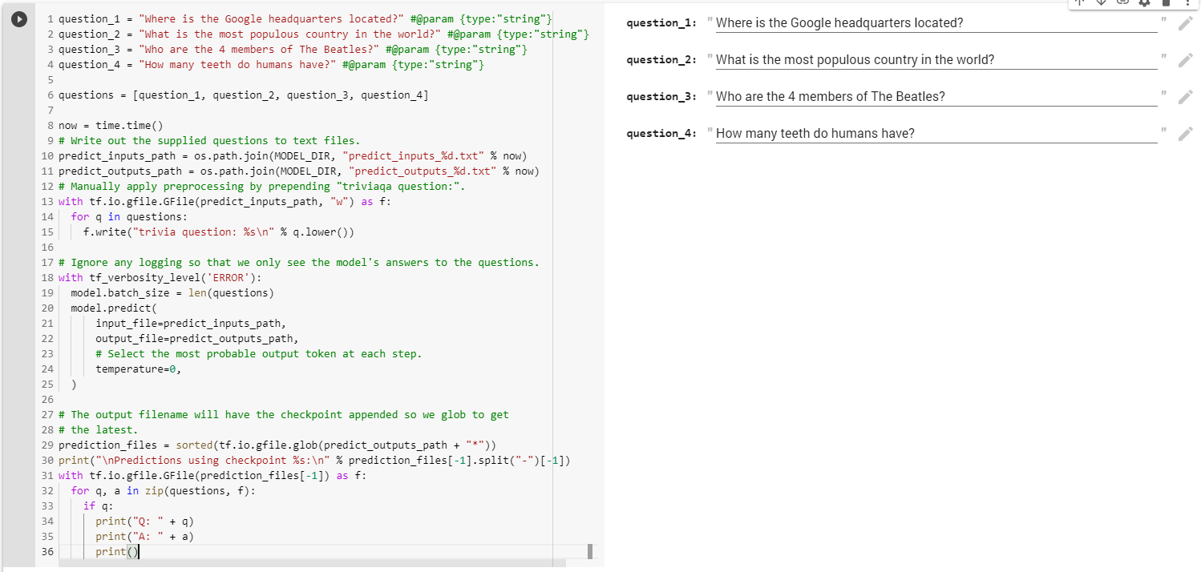
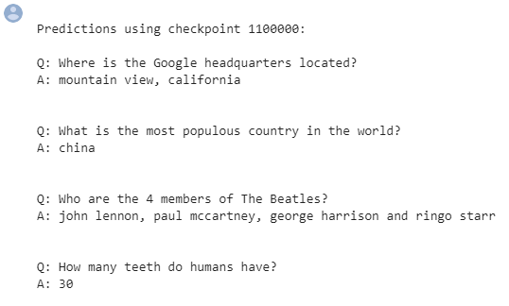
Make new predictions on the trained task

